Slide 1
COLLECTING & SUMMARIZING DATA
WEEK
MKTG2341

Slide 2
Learning Objectives
Outline the causes of errors in the data collection and strategies to minimize these.
Identify the main types of data analyses.
Explain summarization data analysis.
Explain strategic implications of these types of data analyses.

Slide 3
Data Collection Errors

Slide 4
Errors in Marketing Research
Sampling Errors
Can be controlled and measured in probability samples.
Non-sampling Errors
Can not be measured.
Can only be minimized through careful design and controls.

Slide 5
Control of Data Collection Errors
The researcher must take steps to control potential non-sampling errors.
You need different control mechanisms for different sources of errors.

Slide 6
Errors in Field Data Collection
Field Worker Error:
Errors committed by the persons who administer the questionnaires
Respondent Error:
Errors committed by the respondent
Errors may be:
intentional
unintentional

Slide 7
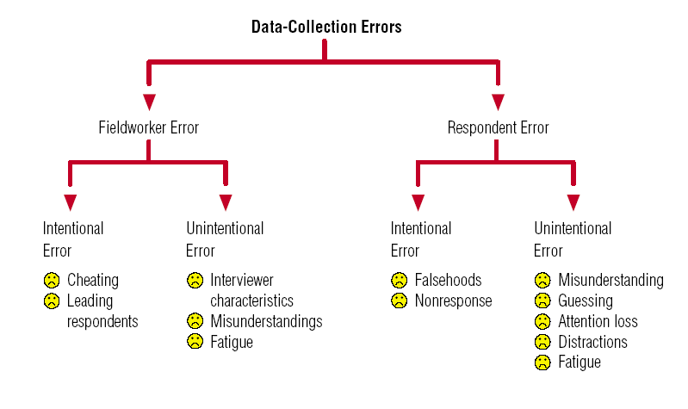
Data Collection Errors
Notes:
First we’ll look at how each of these errors occur.
Next we’ll look at how to prevent them.

Slide 8

Non-Response Errors
When the respondents:
Refuse to participate
Break off the interview
Omit specific questions
The researcher must decide:
Decide when a questionnaire is complete.

Slide 9

Minimize Respondent Errors
Minimize Non-Response errors:
Incentives.
Well designed questionnaire.
Minimize Unintentional Respondent errors:
Clear question wording.
Pretest!

Slide 10

Minimize Field Worker Errors
Interviewer recruitment & work situation.
Interviewer training & project orientation.
Controls.
Validation (10% is standard).

Slide 11

Online Data Collection Errors
Potential Errors:
Multiple submissions.
Bogus respondents and responses.
Population misrepresentation.
Notes:
11

Slide 12
Minimize Online Survey Errors
Controls
Allow single submission only from each email address.
Open-ended question to spot bogus respondents.
Weighing of data for under represented segments.
Use of panel samples.
How would you do that?

Slide 13
Database

Slide 14

Database
Once the data is collected, it must be entered into a database.
Steps:
Database definition
Data entry
Validation
We covered this in both labs last week.
We are using
XL Data Analyst

Slide 15
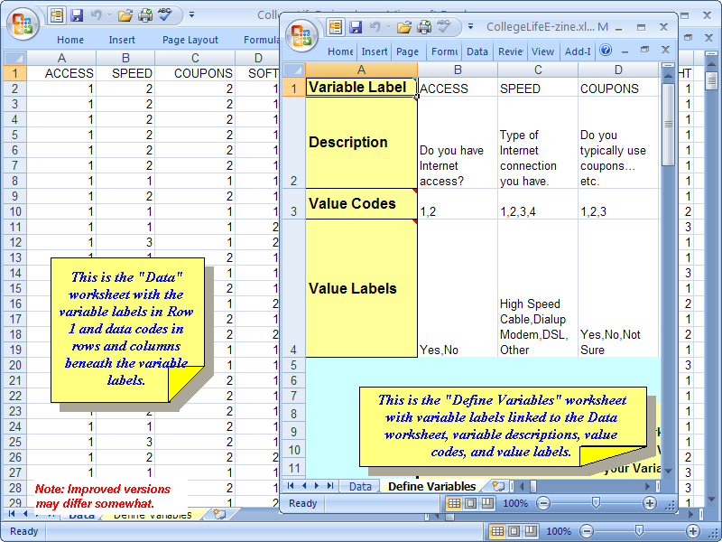
XLDA Database

Slide 16
XLDA Database
Data Sheet:
Variable Label in Row 1.
Link Data Sheet with Define Variable sheet.
Commands: copy | paste special | paste link
Define Variable sheet:
Variable Labels (linked)
Variable Description
Value Codes
Value Labels

Slide 17
Data Analysis

Slide 18

Are you Happy?

Slide 19

Happiness Research
Happiness branding is big business
But too often, marketers fail to understand what brings us joy.
The answer? …
Marketing Research!

Slide 20
Happiness Research
Feature Happiness Survey done by:
Mustel Group, a leading Vancouver-based research company.
James Hoggan and Associates, a large independent public relations company in Vancouver.

Slide 21

GANG VIOLENCE
Notes:
http://www.mustelgroup.com/pdf/a498hs_jha.pdf

Slide 22
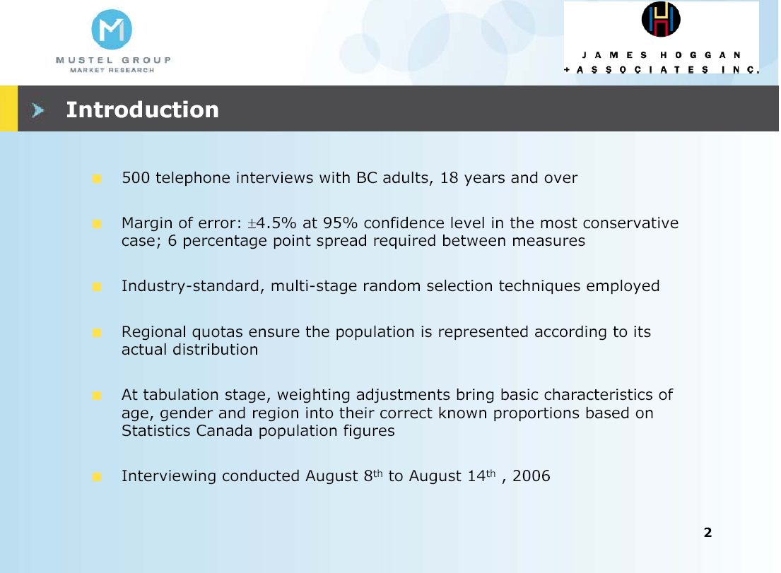
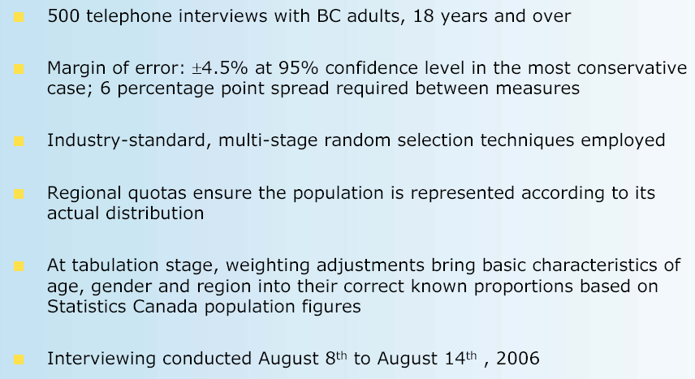

Slide 23
Data Analysis
Once the survey was done
They did the data analysis
Your groups are getting ready to start the data analysis next week.
The rest of this lecture is on data analysis.

Slide 24
TYPES OF DATA ANALYSES

Slide 25
Types of Data Analyses
Description
Data summarization and simple description.
Generalization
Project the sample findings to the population.
Differences
Detect differences in responses.
Relationships
Determine relationships between variables.
Notes:
See Figure 11.3

Slide 26
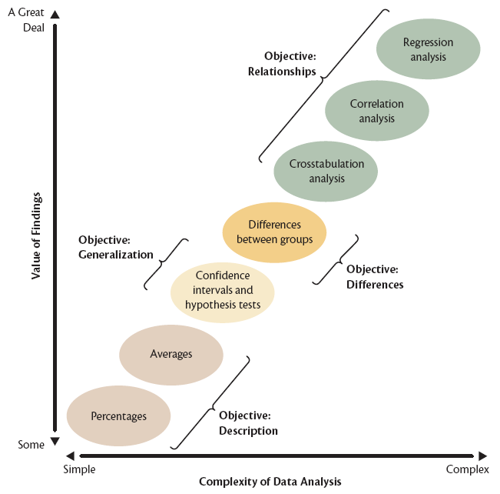
Levels of Analysis

Slide 27
Today: Descriptive Analysis…

Slide 28
Descriptive Analysis
Reduces large amounts of data into a manageable, understandable form.
This means that the data needs to be summarized in a structured way.
Examples:
Grade point averages (GPA)
Runs batted in (RBI)

Slide 29
Descriptive Analysis
PROBLEM: When we summarize, we lose some level of detail – could be a little or a lot.
GPA: was the student taking easy or difficult courses, were the courses in the student’s chosen field of study?
RBI: were the hits home-runs or singles?
Notes:
Grade point averages (GPA)
Runs batted in (RBI)

Slide 30
Descriptive Analysis
However, we can always go back to the detailed data if we need to.
Example:
Collect respondents’ exact ages.
Collapse into broad categories.
Go back to exact age if required.

Slide 31
Summarizing the Data
Characteristics of single variables that should be considered:
Central Tendency
Variability

Slide 32
1. Central Tendency

Slide 33
1. Central Tendency
Central Tendency is an estimate of the ‘center’ of a distribution of values.
Describes the ‘typical’ respondent
Ex: average age of respondent.
Three main measures are:
Mean
Median
Mode

Slide 34
1. Central Tendency
Mean is the same as the ‘average’.
Example:
15+15+15+20+20+21+25+36 = 167
167 ÷ 8 = 20.9
20.9 is the mean

Slide 35
1. Central Tendency
Median is the middle of all values
one-half of the values lies above,
the other half lies below.
Example:
15,15,15,20,20,21,25,36
’20’ is the median

Slide 36
1. Central Tendency
Mode is the value that occurs most
often.
Example:
15,15,15,20,20,21,25,36
’15’ is the mode

Slide 37
2. Variability

Slide 38
2. Variability
Dispersion is the spread of values
around the central tendency.
Two main measures are:
Range
Standard Deviation

Slide 39
2. Variability
Range is the difference between the
highest and lowest values/responses
Example:
The lowest mark on the MKTG 2309 midterm was 89%, the highest mark was 40%. Therefore, the range was
R = 89% – 40 % = 49

Slide 40
2. Variability
Standard Deviation
tells you how tightly the values from your survey are clustered around the overall mean.
is the average distance between all observed measures and the mean of their combined value – the mean of the mean.

Slide 41
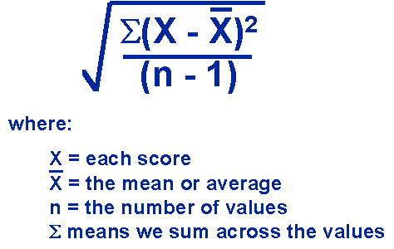
2. Variability

Slide 42
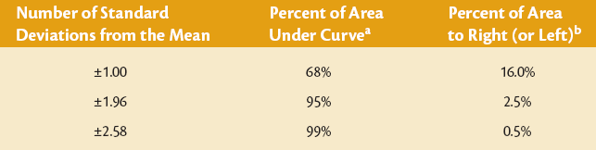
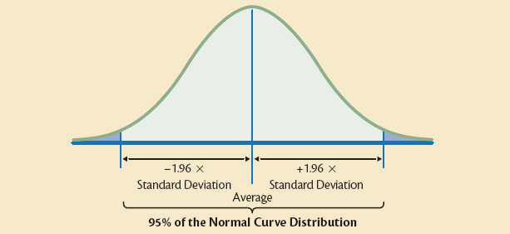
Standard Deviation & Normal Curve
Notes:
42

Slide 43
2. Variability
A small Standard Deviation score:
responses or values tend to be similar (tightly spaced).
A large Standard Deviation score:
responses or values tend to be dissimilar (widely spaced).

Slide 44
When to use each type of analysis…

Slide 45
Summarize the Data
Categorical Variables: Percents
Group the related variables in each run.
Ex. Percent of all demographic variables producing “Respondent Profile”.
Metric Variables: Averages
Group the related variables in each run.
Ex. Include all the categories in one Grid question into one run (producing one table).

Slide 46
Now let’s see this knowledge in action!

Slide 47
GANG VIOLENCE

Slide 48
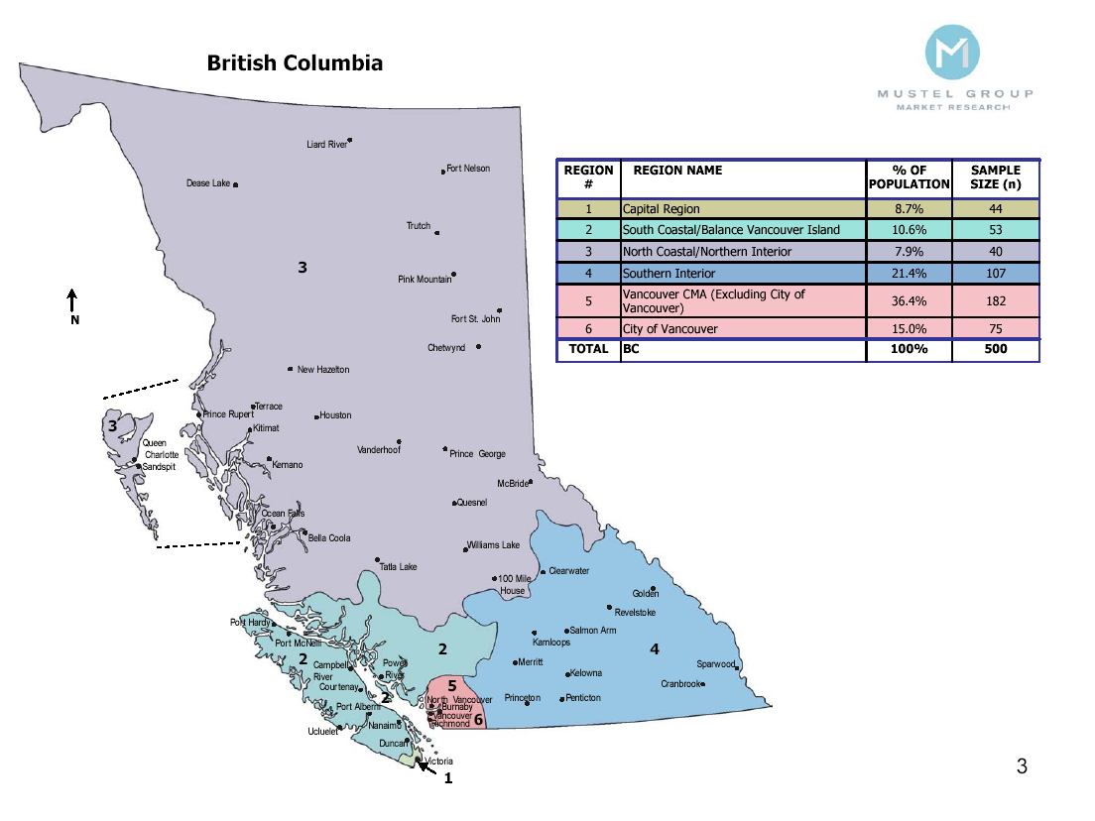
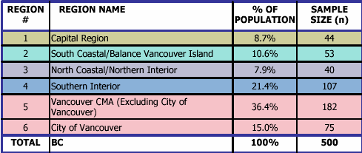

Slide 49
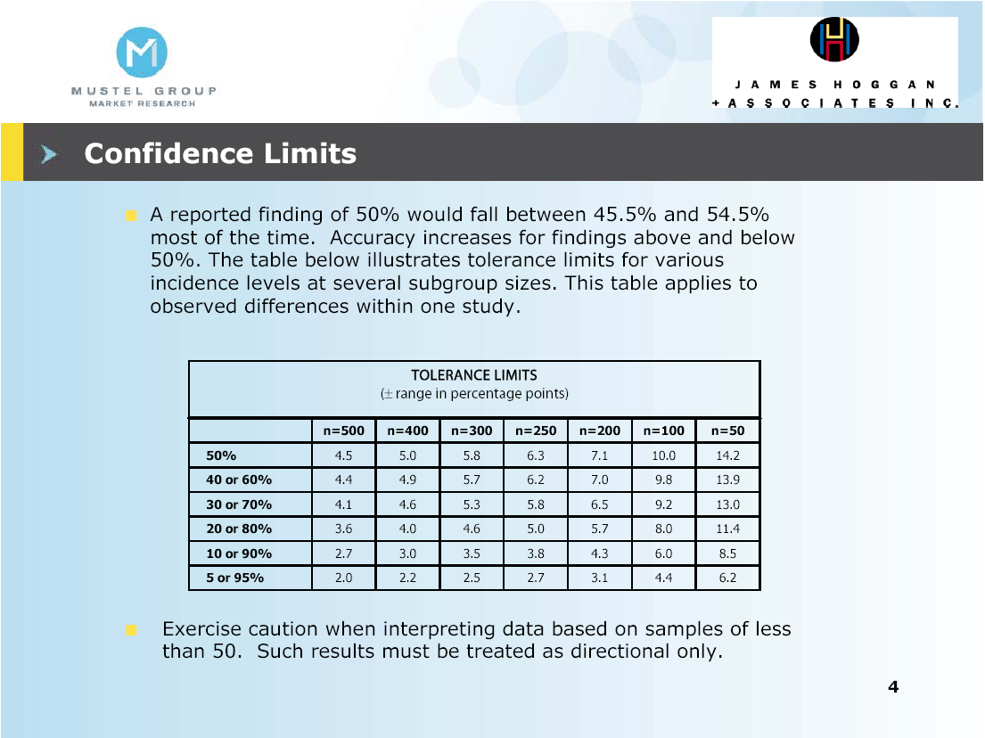
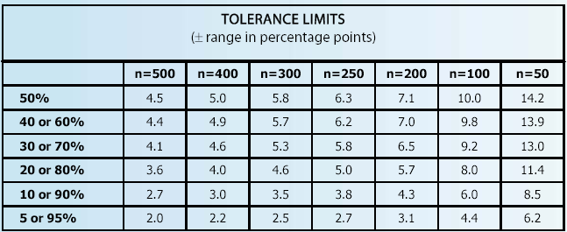

Slide 50


Slide 51


Slide 52
Here’s the summary of Question #1 in a graphical format
(note the mean score)

Slide 53
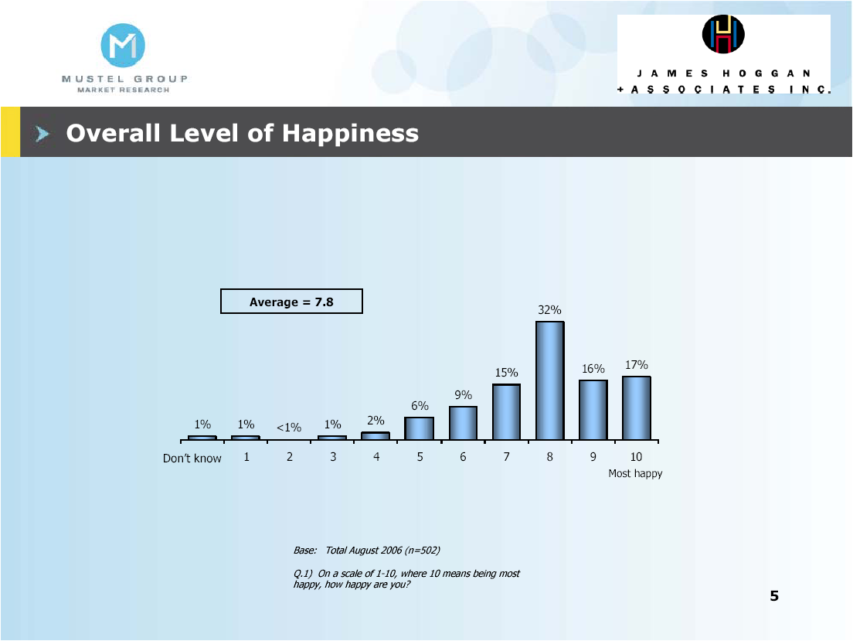
Notes:
Note: mean score, while important and descriptive, hides a lot of detail such as the very small proportion of ‘unhappy’ people

Slide 54
And here’s the data table it was based on…

Slide 55
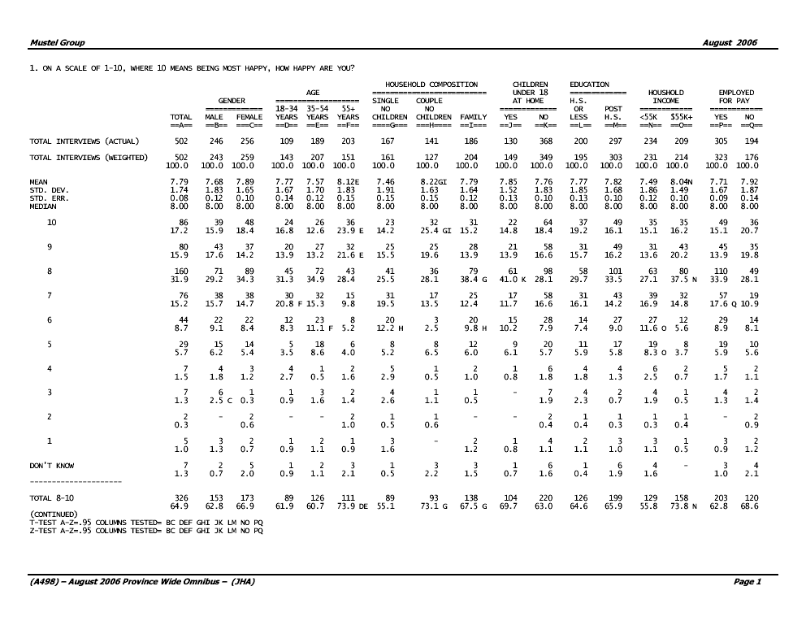

Slide 56
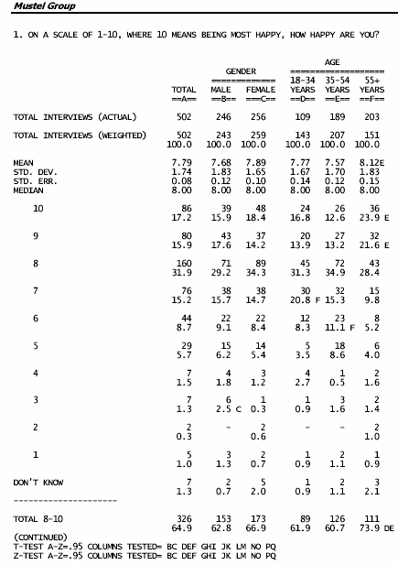
Total weighted & un-weighted
Banner ‘Breaks’
Response Codes (scale)

Slide 57
Analyses conducted: mean, median, standard deviation, standard error
Results for total sample and by gender
Top Score Box

Slide 58
Here is the summary chart for Question #2…

Slide 59
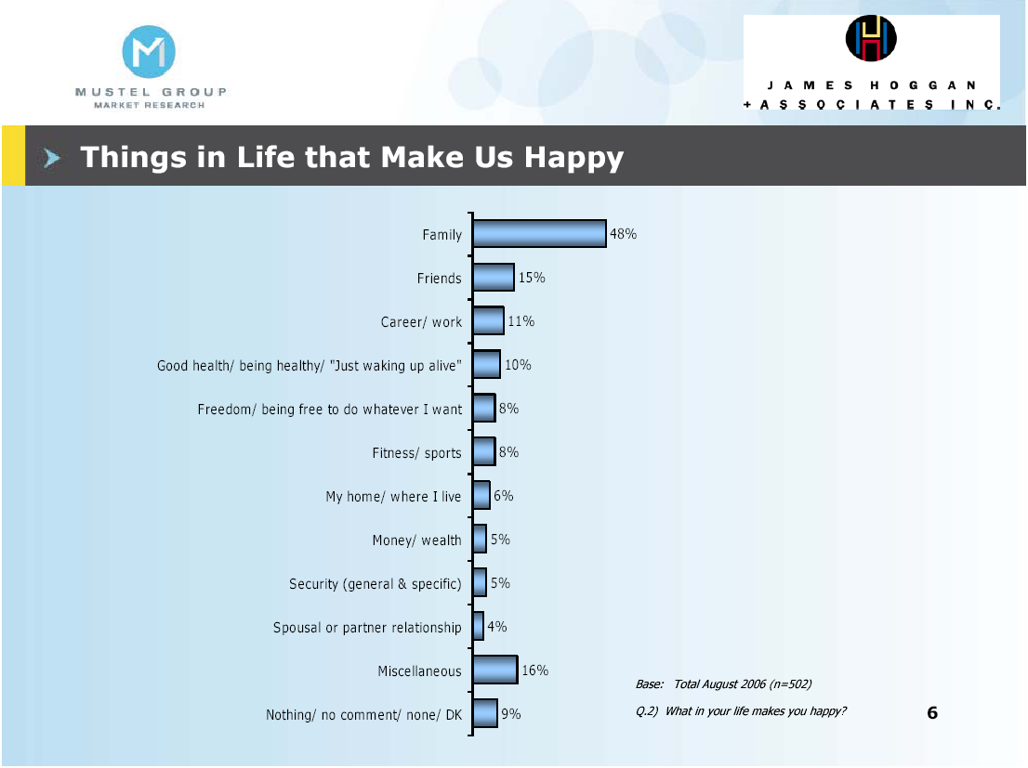
‘Other’ category – large, but expected given the question

Slide 60
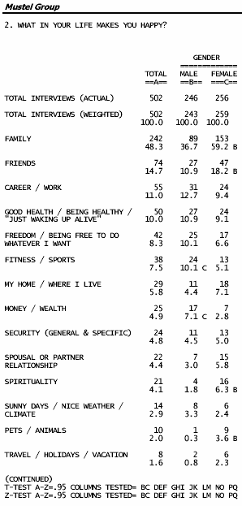
Pct. of females significantly larger than the pct. of males.
Pct. of males significantly larger than the pct. of females.
Bad News?!?
Tests of significance and the columns compared.

Slide 61
Look what happens when you force a decision…

Slide 62
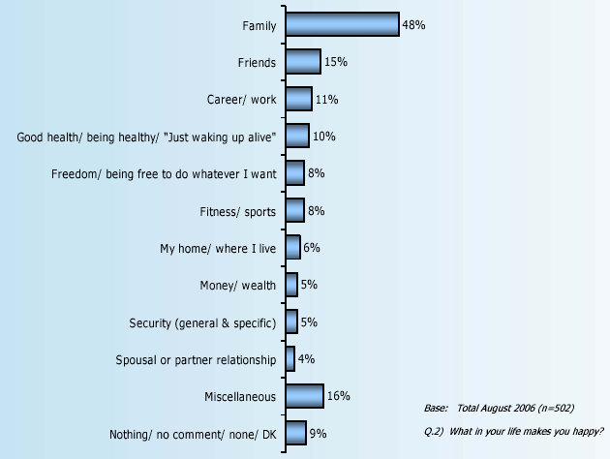
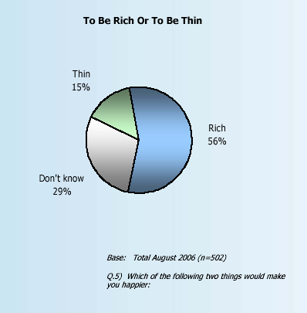
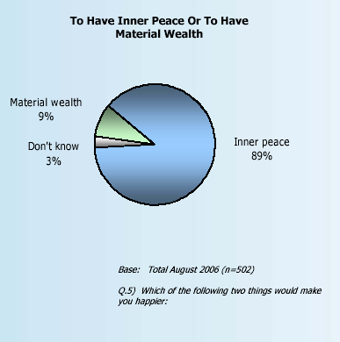

Slide 63
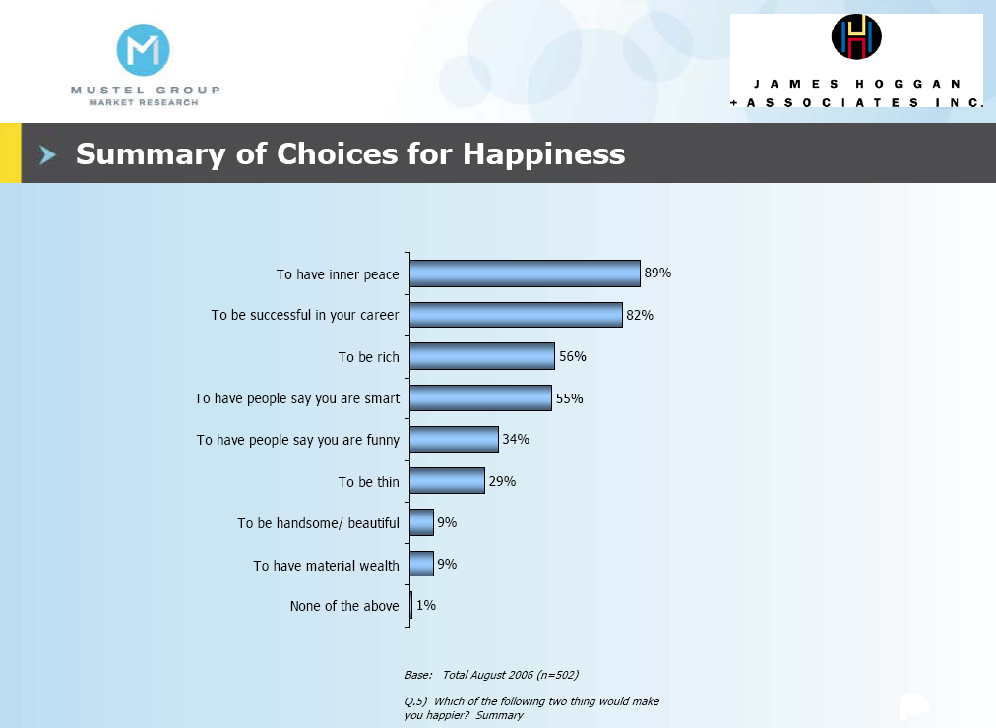

Slide 64
The Respondent Profile

Slide 65
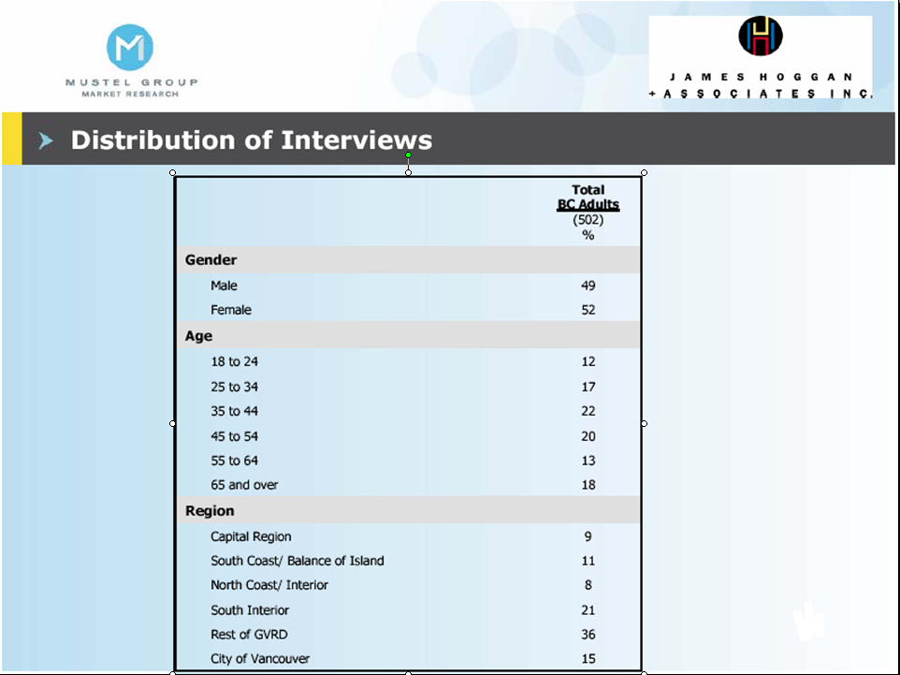
You should all have a Respondent Profile in your report.

Slide 66
Question: What might be some of the marketing implications from these survey findings regarding happiness?

Slide 67

There are some things money can’t buy
For Christmas there is MasterCard
Notes:
If time:
http://www.youtube.com/watch?v=IajOINu0V2Y
Not used:
Success Interview with Brian Tracy:
http://www.youtube.com/watch?v=O3df68vS7Dk
Master Card commercials:
http://www.youtube.com/watch?v=J8kMrLx6_aQ

Slide 68
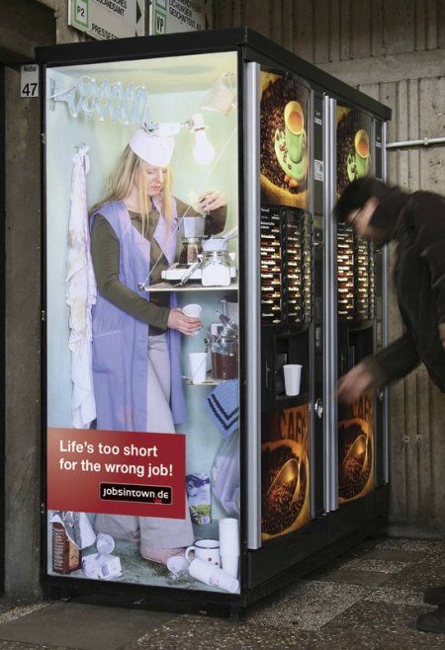
Notes:
Fear of Unhappiness used in Marketing

Slide 69
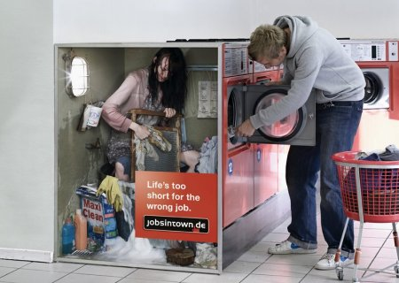
Notes:
Fear of Unhappiness used in Marketing
Source of the picture:
http://www.moillusions.com/2006/05/lifes-too-short-for-wrong-job.html

Slide 70
The Six Step Approach to Data Analysis & Presentation

Slide 71
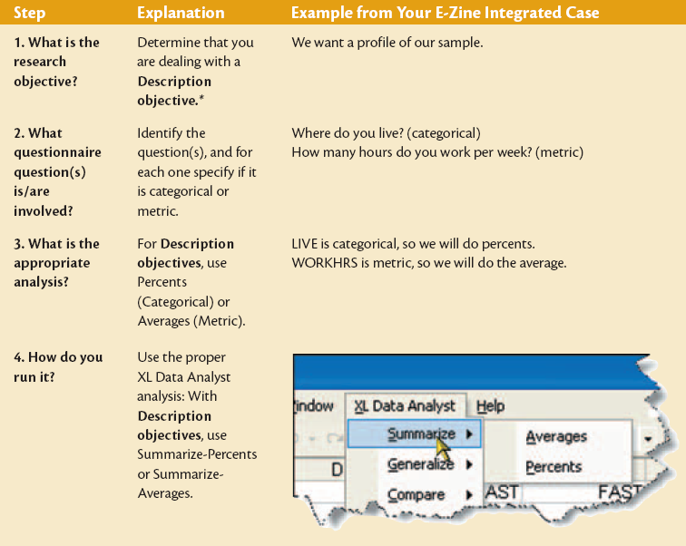
Notes:
71

Slide 72
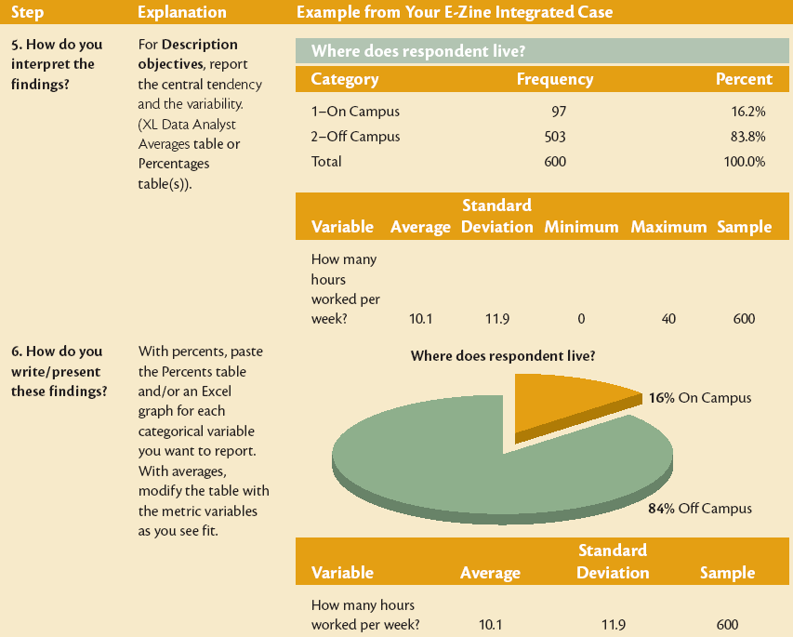
Notes:
72

Slide 73
Summarizing Analysis for Your Project
Single Response | CATEGORIGAL DATA Percent: table and chart. Group analysis by Res. Objectives. METRIC DATA Average: table (or simply report the value) Group analysis by Res. Objectives.
Multiple Response | Multiple Response Tables: Use Snap tables or create manually in Excel. Group analysis by Res. Objectives.
Grid Rating | Compare Averages: Analyze all grid categories in one grid question. Chart of Averages: Manually make a Chart based on the mean scores. Percent and Graphs for each grid category.
Notes:
Because rating questions also have categories, you can create Percent Frequencies and bar charts for them.

Slide 74
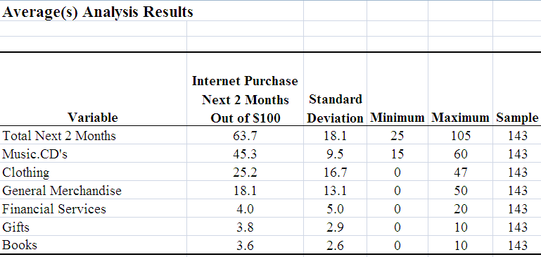
Comparing Averages
In Excel use the chart function to create Bar Chart based on the table with the means

Slide 75
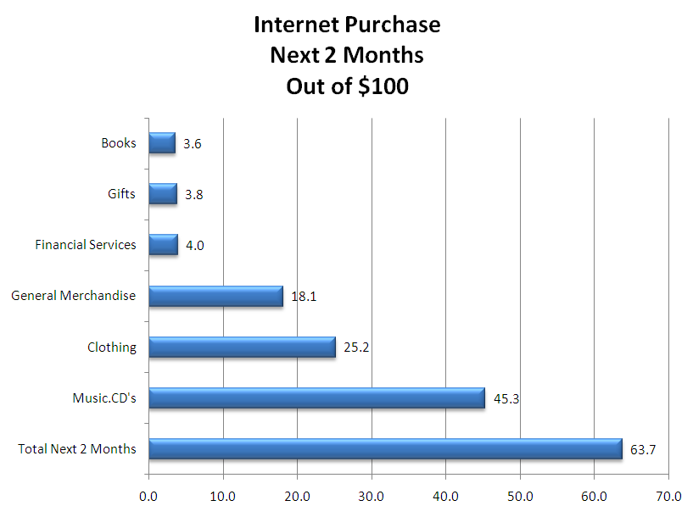
Comparing Averages
Easier to compare Means with Bar Chart

Slide 76
Rating Questions
Several ways to analyze Rating Qs:
Average for a one-variable rating question.
Comparing Average for Grid Questions.
Percents for the individual grid categories.
Because rating questions have categories, you can also run percents & charts for each category (variable).

Slide 77
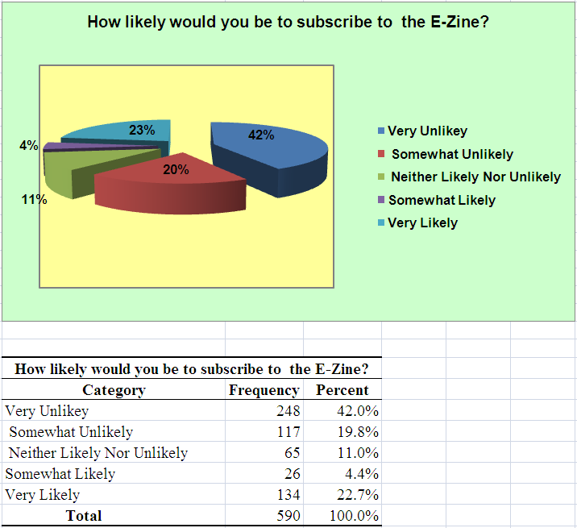
Rating Question: Percents
Pie Chart with more than 4 categories, is too hard to read.

Slide 78
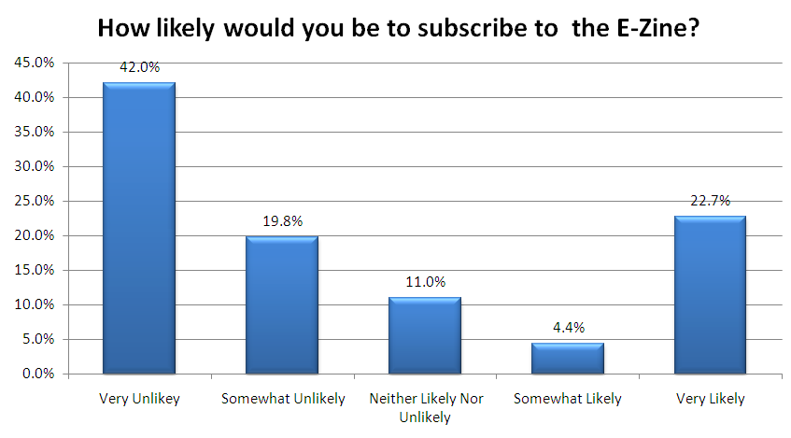
Rating Question: Percents
Bar Chart is easier to read for this data
Percent analysis can identify segments

Slide 79
Review – 3 Topics:
Errors in the Data Collection:
Sampling & non-sampling errors.
Controls must be put in place.
Database
See PC Lab 8 Power Point file.
Data Analysis – Summarizing
Categorical Data: Percents.
Metric Data: Average.

Slide 80
Reminder!
Data Collection should be finished by next week.
If you have not reached your targeted sample size, check with me before stopping the survey.
You may need an extension on the Populated Database due date.

